Slide 1
Google Glass HUD

Slide 2

Weaknesses
Google Glass HUD

Slide 3
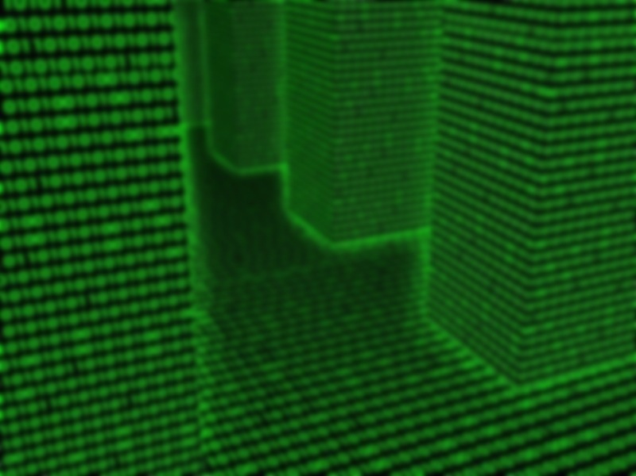
Weaknesses
Google Glass HUD

Slide 4
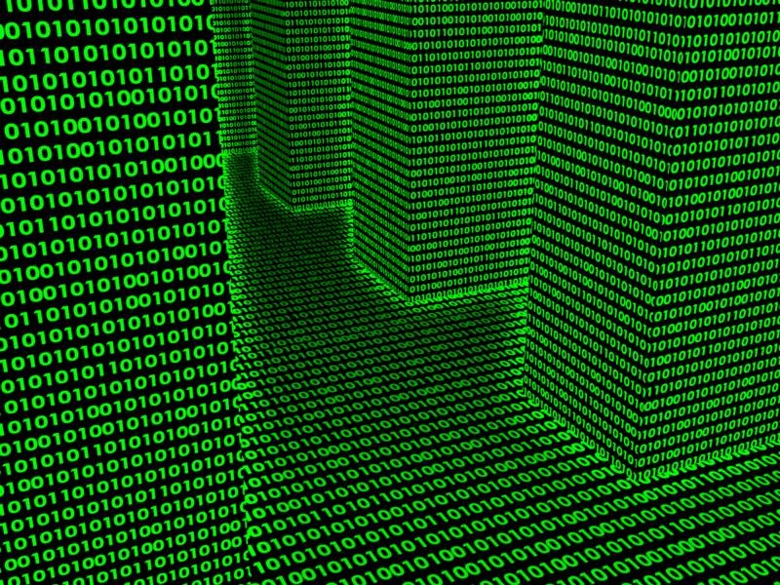
Google Glass HUD

Slide 5
Google Glass HUD
Agustin Marquez
Alvaro Correa
Justin Callanan
Sandra Rubio
Google Glass HUD

Slide 6
What We Do
Gather
SENSOR DATA
Store
Display
Google Glass HUD

Slide 7
Gathering Data
Push API:
Used for sending your own data to our service
Processing:
Built to handle a wide variety of sensor data
Xbee sensor networks, weather stations, etc.
Google Glass HUD

Slide 8
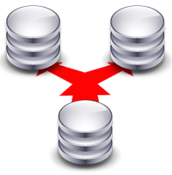
Storing Data
MongoDB:
Stores data on a remote server
Gives access to data on-demand with Google Glass, mobile applications, or a web application
Google Glass HUD

Slide 9
Displaying Data
Google Glass App:
Voice activated
Connects to MongoDB
Formats and displays sensor data
Multiple views:
All data
Most recent data
Data within a specified range
Google Glass HUD

Slide 10
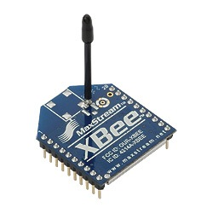
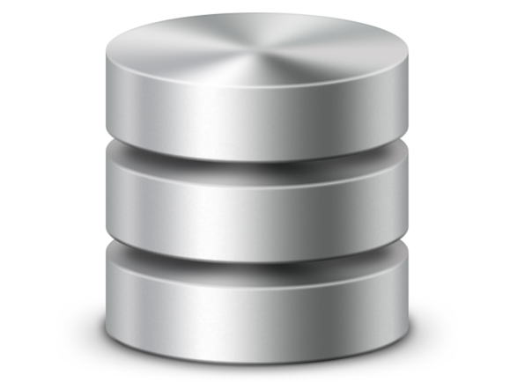
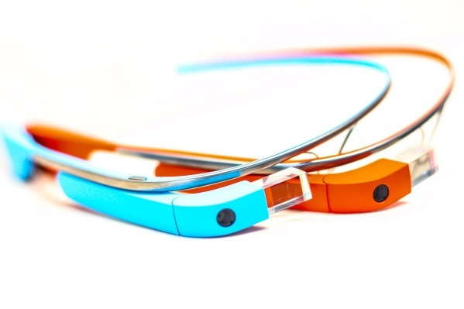
System Architecture
MongoDB
Processing
Glass
Push API
Google Glass HUD

Slide 11
Requirements
MongoDB Database Server
Free version: 500MB
6.250.000 entries
+4.000 sensors pushing data every minute
Future Plans
$5 each GB ~ 8.000 sensors
Google Glass HUD

Slide 12
Our Team
Agustin Marquez
Application engineer. Spanish ITM graduate student.
Alvaro Correa
Back-end engineer. Spanish ITM graduate student.
Justin Callanan
Mobile developer. ITM undergraduate student.
Sandra Rubio
Front-end engineer. Spanish ITM graduate student.
Google Glass HUD

Slide 13
Special Thanks
To our professors, Jeremy Hajek and Dan Tomal, and to Google Glass consultant Val Scarlata
Google Glass HUD

